Slide 1
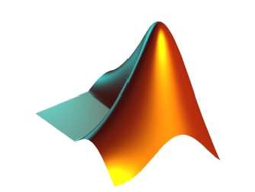
APPLICATIONS OF
MATLAB IN ENGINEERING
Yan-Fu Kuo
Dept. of Bio-industrial Mechatronics Engineering
National Taiwan University
Today:
Fall 2015
•
•
•
Introduction to digital image
Read and show images
Image arithmetic

Slide 2
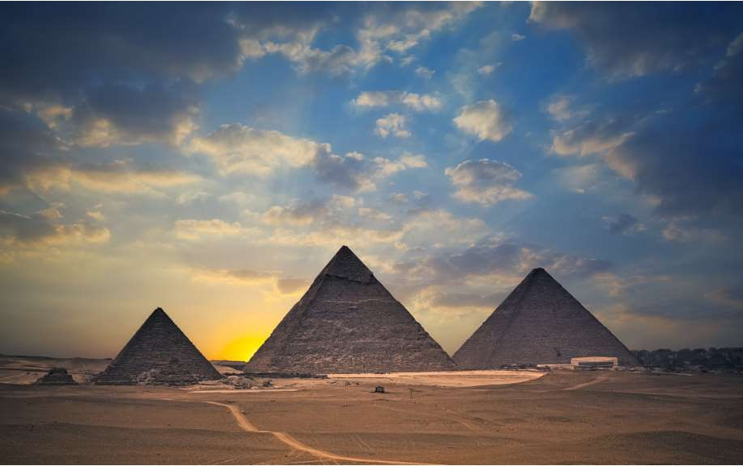

Applications of MATLAB in Engineering
Y.-F. Kuo
2
Digital Image and ItsAcquisition
• An image is an artifact
that depicts or records
visual perception
• Typically acquired by
using charge-coupled
device (CCD) or
complementary metal-
oxide-semiconductor
(CMOS) devices

Slide 3
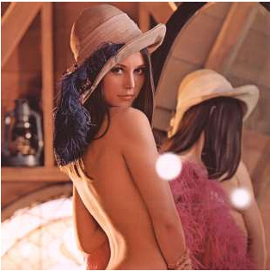
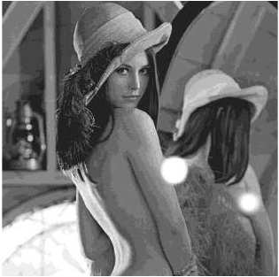
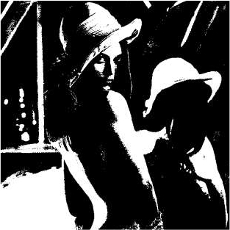
Applications of MATLAB in Engineering
Y.-F. Kuo
3
Types of Digital Image
• Binary: Each pixel is just black or white
• Grayscale: Each pixel is a shade of gray, normally from 0
(black) to 255 (white)
• True color or RGB: Each pixel has a particular color
described by the amount of red, green and blue in it

Slide 4
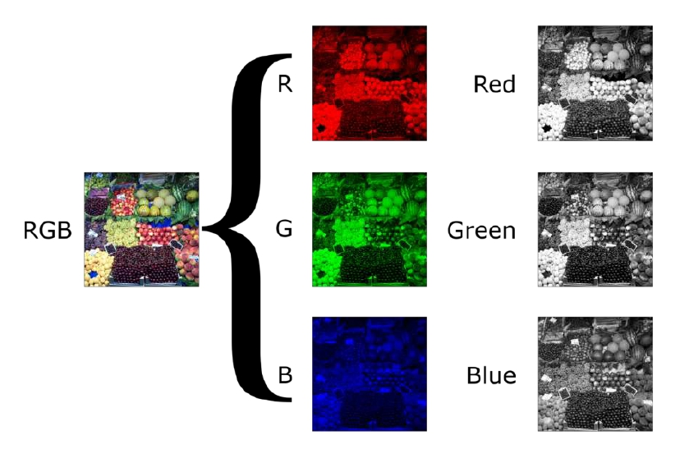
Applications of MATLAB in Engineering
Typical RGB Image
Y.-F. Kuo
4

Slide 5
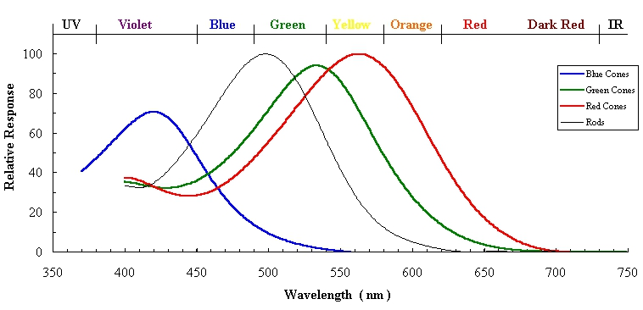
Applications of MATLAB in Engineering
Y.-F. Kuo
5
Why RGB?
• Three kinds of light-sensitive photoreceptor cells
in the human eye (i.e., cone cells) respond most
to red, green and blue

Slide 6

Y.-F. Kuo
6
Applications of MATLAB in Engineering
Elements of Images
Pixels

Slide 7
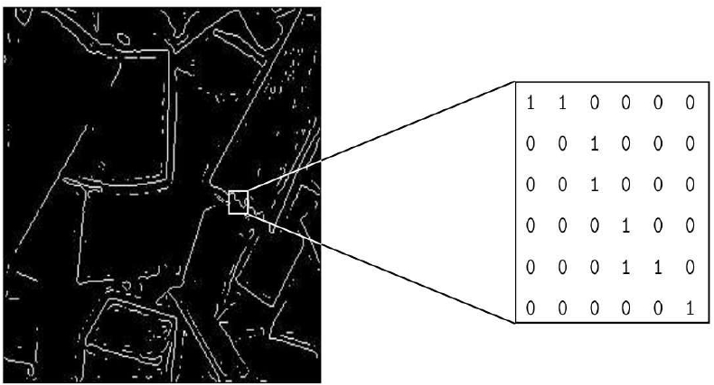
Applications of MATLAB in Engineering
Binary Image
Y.-F. Kuo
7

Slide 8
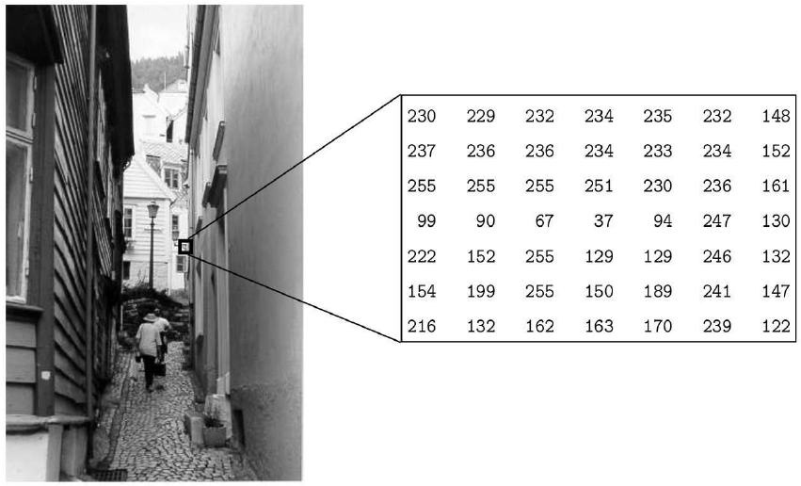
Applications of MATLAB in Engineering
Greyscale Image
Y.-F. Kuo
8

Slide 9
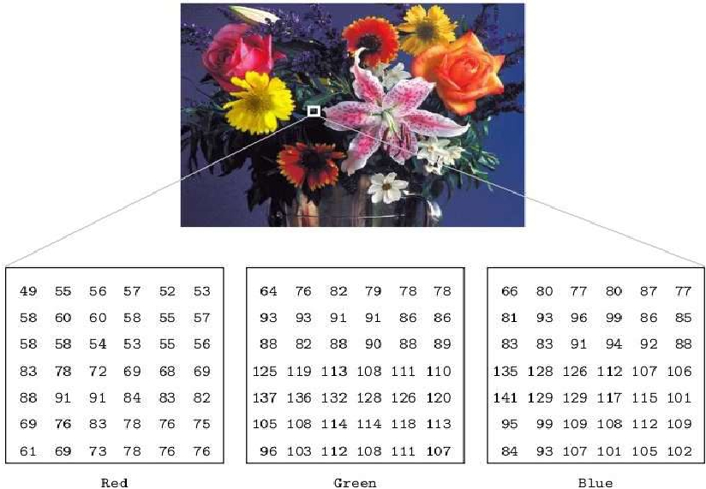
Applications of MATLAB in Engineering
Color Image
Y.-F. Kuo
9

Slide 10
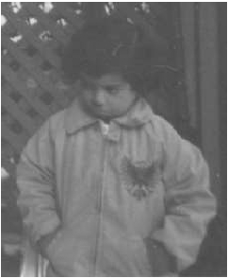
Applications of MATLAB in Engineering
Y.-F. Kuo
10
Read and ShowAn Image
• Read an image: imread()
• Show an image: imshow()
• Example:
clear, close all
I = imread('pout.tif'); %read
imshow(I); %show

Slide 11
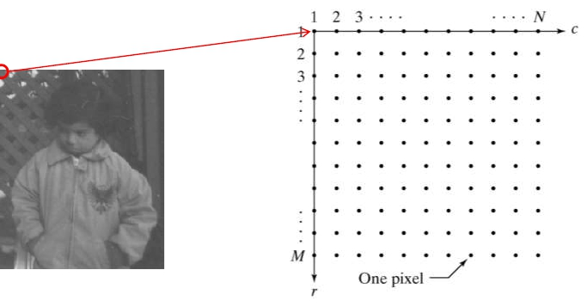
Applications of MATLAB in Engineering
Y.-F. Kuo
11
Image Variable in Workspace
whos
Name
I
Size
291x240
Bytes
69840
Class
uint8
• Image matrix:

Slide 12
Applications of MATLAB in Engineering
Y.-F. Kuo
12
Image Info: imageinfo('pout.tif')
Filename
FileModDate
FileSize
Format
Width
Height
BitDepth
ColorType
FormatSignature
ByteOrder
BitsPerSample
SamplesPerPixel
RowsPerStrip
StripByteCounts
XResolution
YResolution
ResolutionUnit
MaxSampleValue
MinSampleValue
C:\Program Files\MATLAB\R2014a\toolbox\images\imdata\pout.tif
25-九月-2013 16:12:06
69004
tif
240
291
8
grayscale
[73 73 42 0]
little-endian
8
1
34
[1x9 double]
72
72
Inch
255
0

Slide 13
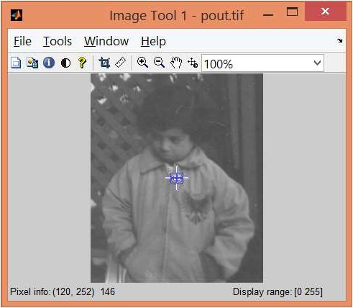
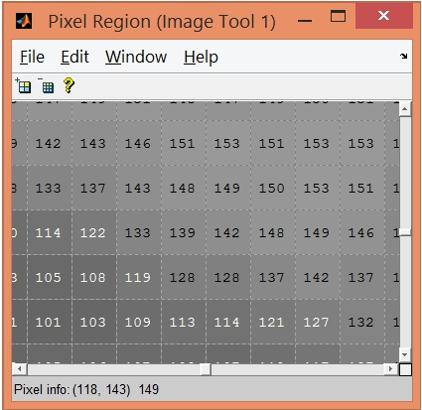
Applications of MATLAB in Engineering
Y.-F. Kuo
13
Image Viewer: imtool('pout.tif')
• Get pixel information in image viewer

Slide 14
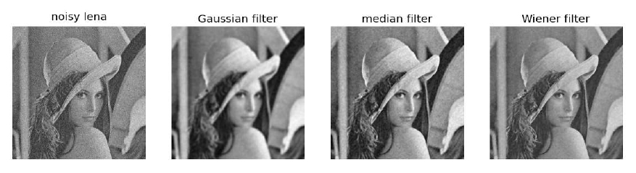
Applications of MATLAB in Engineering
Y.-F. Kuo
14
Image Processing
• Any form of signal processing for which the input
is an image

Slide 15
Applications of MATLAB in Engineering
ImageArithmetic
Y.-F. Kuo
15
imabsdiff
imadd
imapplymatrix
imcomplement
imdivide
imlincomb
immultiply
imsubtract
Absolute difference of two images
Add two images or add constant to image
Linear combination of color channels
Complement image
Divide one image into another or divide image
by constant
Linear combination of images
Multiply two images or multiply image by
constant
Subtract one image from another or subtract
constant from image

Slide 16
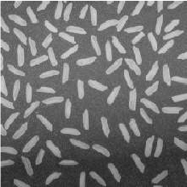
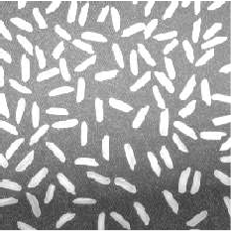
Applications of MATLAB in Engineering
Y.-F. Kuo
16
Image Multiplication: immultiply()
I=imread('rice.png');
subplot(1,2,1); imshow(I);
J=immultiply(I, 1.5);
subplot(1,2,2); imshow(J);
• How to reduce the brightness of the image?

Slide 17
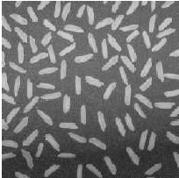
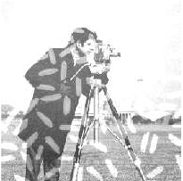
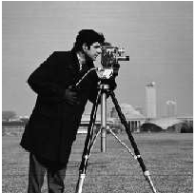
Applications of MATLAB in Engineering
Y.-F. Kuo
17
ImageAddition: imadd()
I=imread('rice.png');
J=imread('cameraman.tif'); K=imadd(I,J);
subplot(1,3,1); imshow(I);
subplot(1,3,2); imshow(K);
subplot(1,3,3); imshow(J);

Slide 18
Applications of MATLAB in Engineering
Y.-F. Kuo
18
Practice
• Adjust the “brightness” and “contrast” of
rice.png and display it on the screen

Slide 19
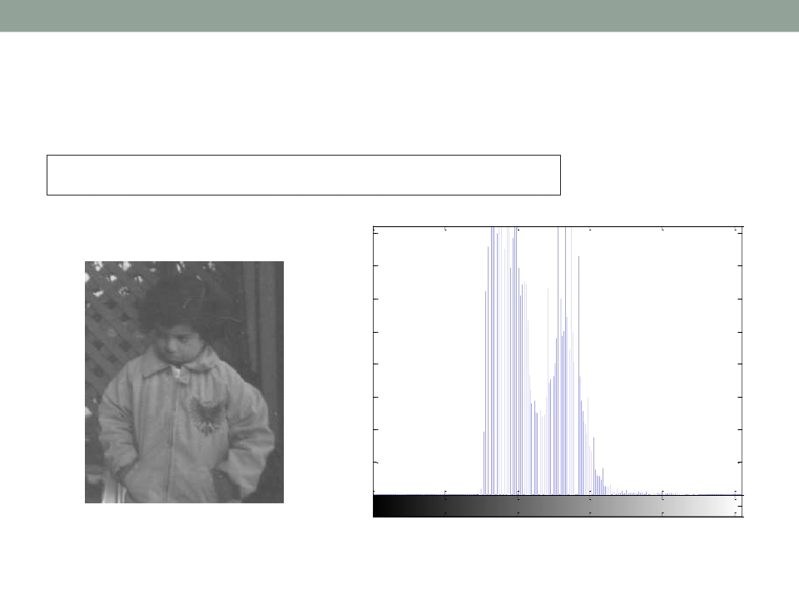
Applications of MATLAB in Engineering
Y.-F. Kuo
19
Image Histogram: imhist()
imhist(I)
1600
1400
1200
1000
800
600
400
200
0
0
50
100
150
200
250

Slide 20
Applications of MATLAB in Engineering
Y.-F. Kuo
20
Practice
• Plot the histograms of the images before and
after the “brightness” and “contrast” adjustment
for rice.png

Slide 21
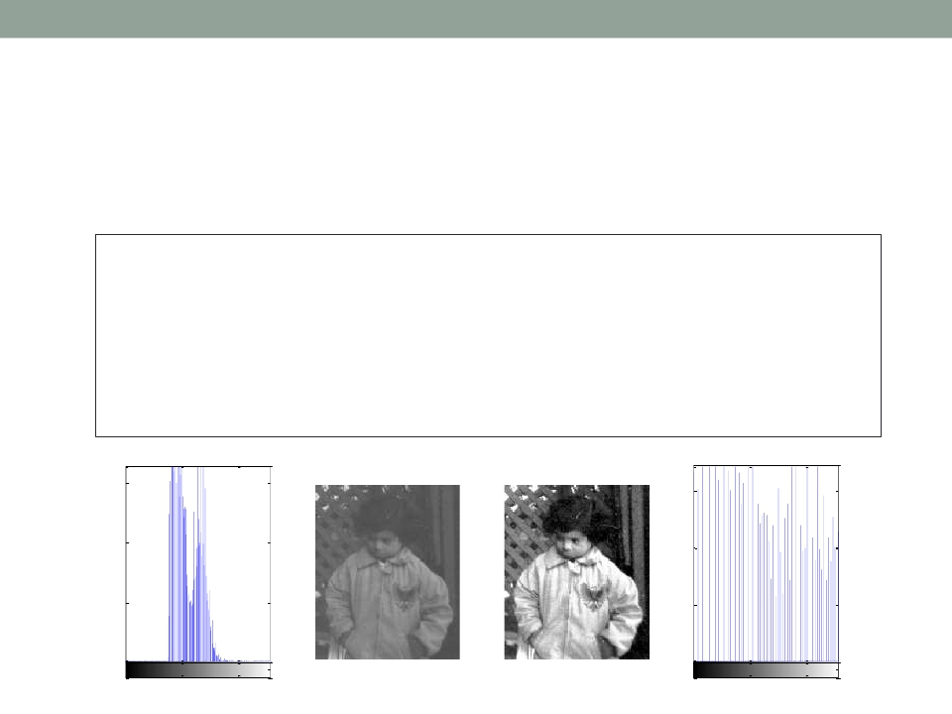
Applications of MATLAB in Engineering
Y.-F. Kuo
21
Histogram Equalization: histeq()
• Enhances the contrast of the image
I = imread('pout.tif'); I2 = histeq(I);
subplot(1,4,1); imhist(I);
subplot(1,4,2); imshow(I);
subplot(1,4,3); imshow(I2);
subplot(1,4,4); imhist(I2);
1500
1000
500
0
1500
1000
500
0
0
100
200
0
100
200

Slide 22
Applications of MATLAB in Engineering
Y.-F. Kuo
22
Practice
• Write your own equalization function, try it on
pout.tif, and display it on the screen

Slide 23
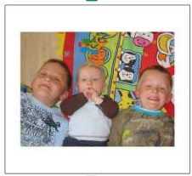


Applications of MATLAB in Engineering
Y.-F. Kuo
23
Geometric Transformation
• Moving the coordinates (Not the gray-levels) of
the pixels in an image

Slide 24
Applications of MATLAB in Engineering
Y.-F. Kuo
24
GeometricTransformation Matrices (2D)
http://www.mathworks.com/help/images/performing-general-2-d-spatial-transformations.html
Transform | Example | Transformationmatrix
Translation |  | 𝑥′10𝑡𝑥𝑥 𝑦′=01𝑡𝑦𝑦 10011
Scale imresize() |  | 𝑠𝑥00 0𝑠𝑦0 001
Shear |  | 1ℎ𝑥0 ℎ𝑦10 001
Rotationwith𝜃 (clock-wise) imrotate() |  | cos𝜃sin𝜃0 −sin𝜃cos𝜃0 001

Slide 25
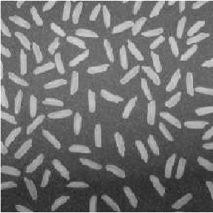
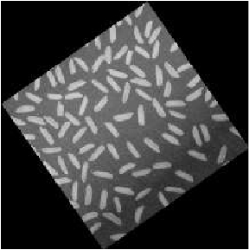
Applications of MATLAB in Engineering
Y.-F. Kuo
25
Image Rotation: imrotate()
I = imread('rice.png'); subplot(1,2,1);
imshow(I); J = imrotate(I, 35, 'bilinear');
subplot(1,2,2); imshow(J);
size(I)
size(J)

Slide 26
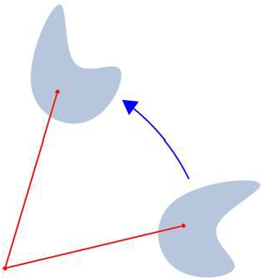
Applications of MATLAB in Engineering
Y.-F. Kuo
26
Image Rotation
• In two dimensions, rotation of a point (𝑥,𝑦) for an
angle 𝜃 “counter-clockwise” can be written as:
𝑥′
𝑦
cos𝜃
sin𝜃
−sin𝜃 𝑥
𝑦
′ =
cos𝜃

Slide 27
Applications of MATLAB in Engineering
Y.-F. Kuo
27
Write Image: imwrite()
• Format supported: 'bmp', 'gif', 'hdf', 'jpg', 'jpeg',
'jp2', 'jpx', 'pcx', 'pnm', 'ppm', 'ras', 'tif', 'tiff', 'xwd'
• Example:
imwrite(I, 'pout2.png');

Slide 28

Applications of MATLAB in Engineering
End of Class
Y.-F. Kuo
28

